Slide 1
A
Presentation on
Healthy
Living

Slide 2
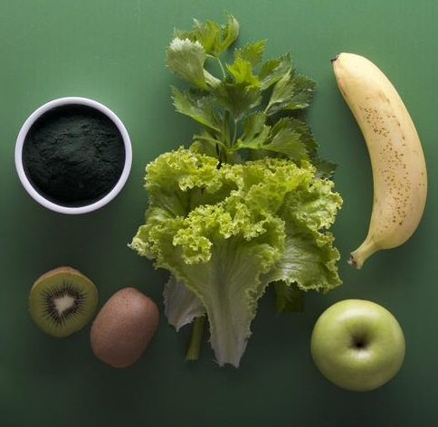
Healthy Living
Right Mix of values
Be your own master
Believe in yourself
Dovelop your personality

Slide 3
Right mix of values

